Slide 1


Meeting 2
Attendance QR (Week 3, Session 2)

Slide 2
Meeting 3
STM32 Design Requirements
IEEE - CSULB Branch

Slide 3
Agenda
Introduction to Datasheets
Power Requirements
Decoupling and Bulk Capacitors
Clock Signals
Programming/Debugging Interface
Reset Circuit
Demo: Bulk Capacitor
Supplemental Demo: Flickering Lights

Slide 4
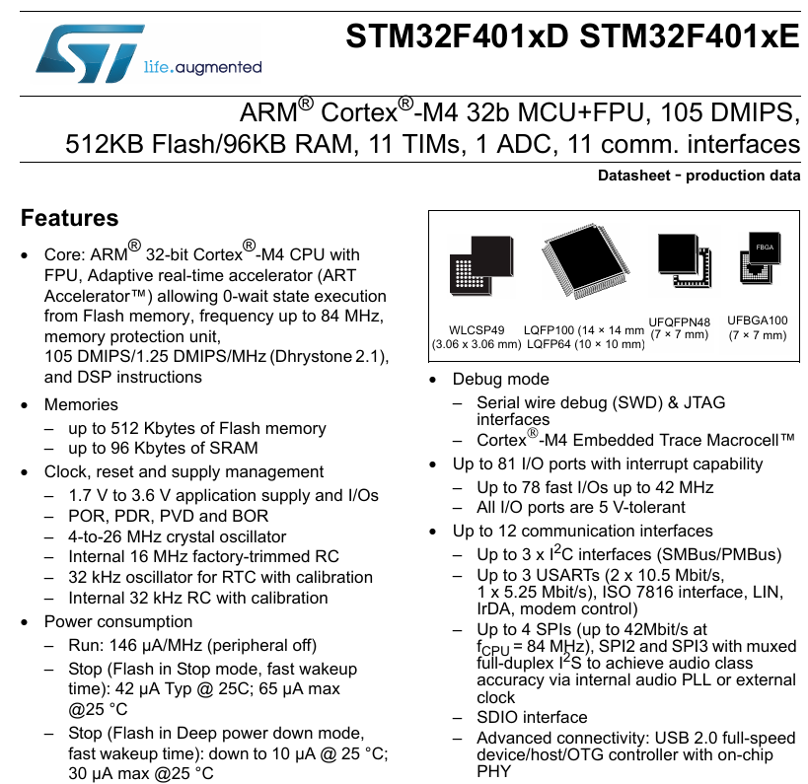
Introduction to Datasheets
Datasheets, or specs, are technical documents provided by the manufacturer that contain detailed information about a product:
Electrical (or other characteristics)
Pinout and configuration
Peripherals and functionality
Critical tool for the engineer, but takes practice.
We will reference the datasheet for our STM32.
Recommend to read NUCLEO Board User Manual.
Notes:
Mention that spec sheet is used in industry

Slide 5
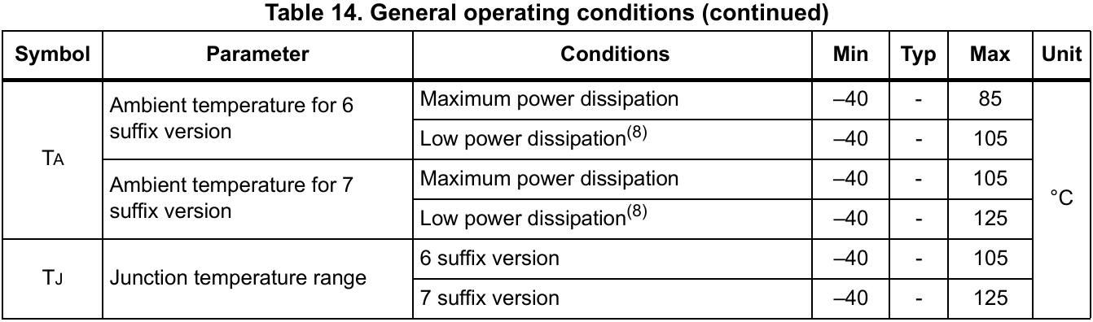
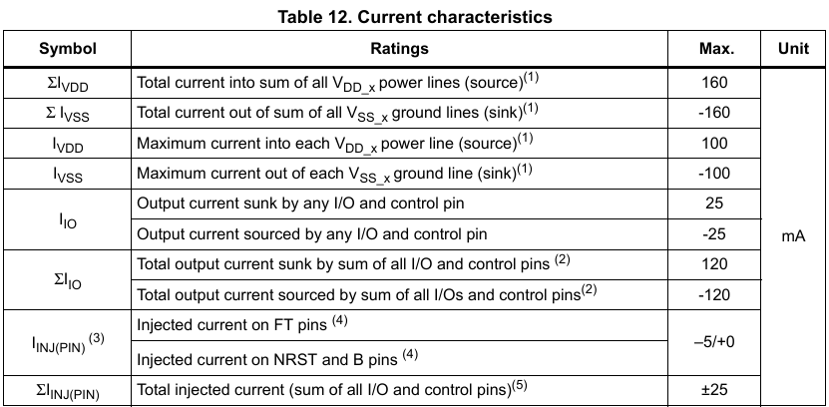
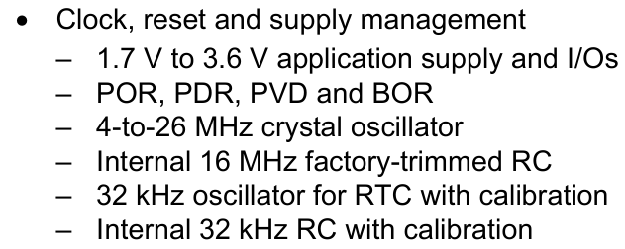
Power Requirements
(3)
Electronic components require electrical power to function and typically have specifications based on:
Supply voltage (1)
Current Characteristics (2)
Ambient Temperature impact on power consumption (3)
Noise tolerance
(2)
(1)

Slide 6
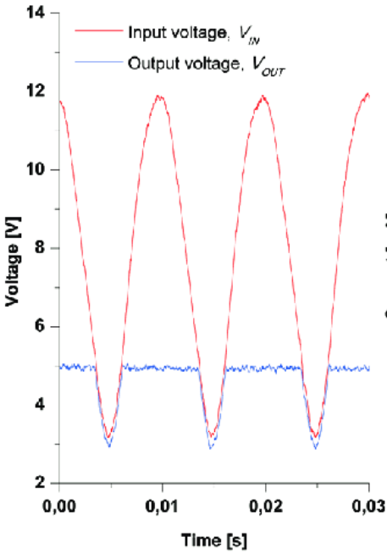
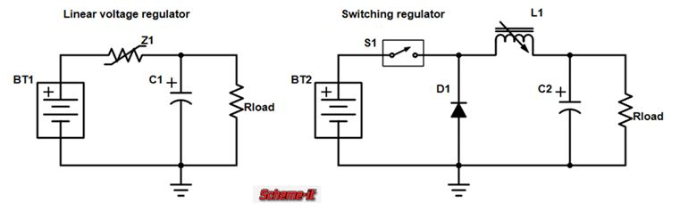
Power Requirements (cntd.)
Voltage regulators are used to provide a stable and constant output voltage regardless or input voltage or load current.
There are two types of regulators: linear and switching
Linear regulators are used for low-power applications where the input voltage must be higher than output.
Switching regulators have higher efficiency and can step-up, step-down, and invert voltage at the cost of more design complexity and noise.
Our dev board uses low-dropout (LDO) linear regulators for the board components.

Slide 7
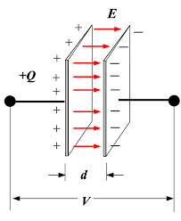
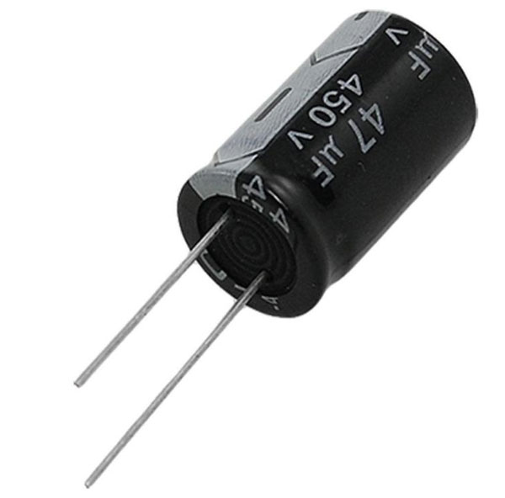
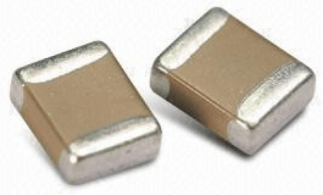
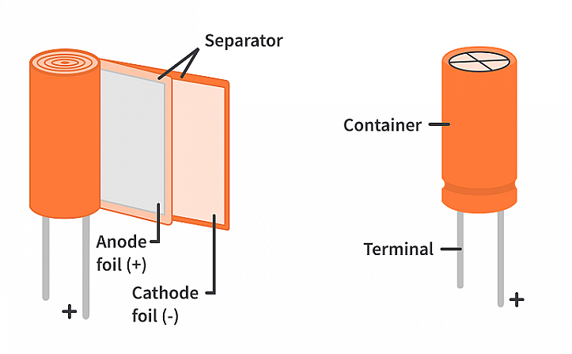
Decoupling and Bulk Capacitors
Capacitors store electric charge or energy in an electric field between its two plates.
They supply current to resist sudden changes in voltage across the plates.
Important for filtering noise in voltage supplies or supplying current during sudden voltage changes.
Electrical noise is caused by impedance from wires and current spikes from loads.

Slide 8
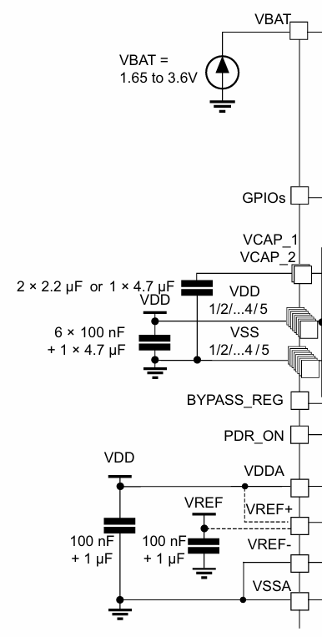
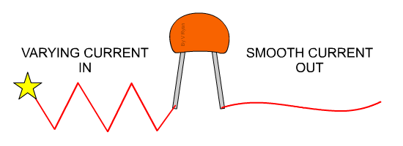
Decoupling and Bulk Capacitors (cntd.)
Decoupling Capacitors are placed closely to the power pins of an IC to filter out high frequency noise.
Typical values are smaller (0.1µF to 10µF)
Bulk Capacitors are used to store energy for stable power supply and smooth voltage fluctuations during sudden current demands.
Typical values are larger (10µF or 100µF)
Good bypassing formula is X_{C} < 0.1R

Slide 9
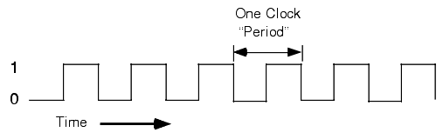
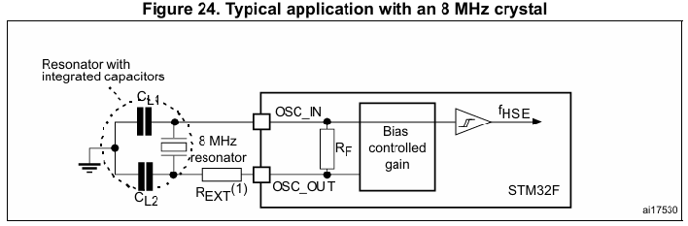
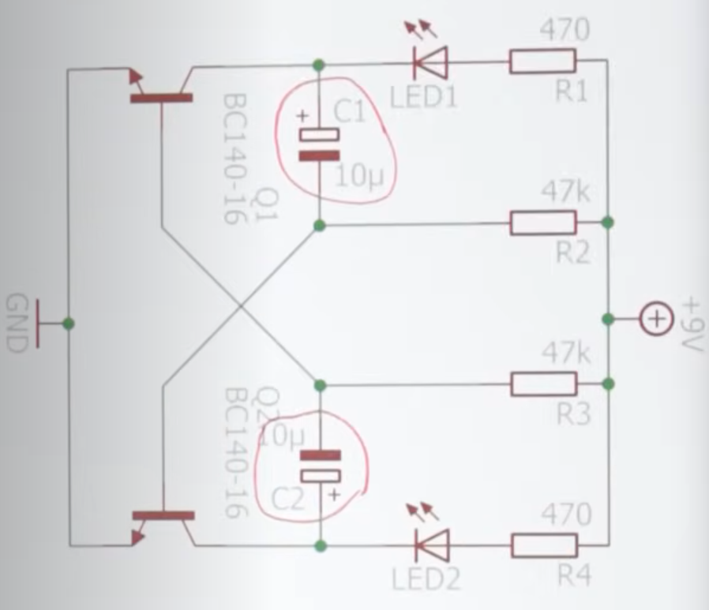
Clock Signals
Clock Signals use rising or falling edges to synchronize bits that are transmitted or received by a microcontroller.
Used by core system clock, peripherals, real-time clock (RTC), sampling, etc.
RC oscillators and crystal oscillators create clock signals.
STM32 series have internal RC oscillators for high-speed (HSI) and low-speed (LSI) applications.
External crystal oscillators (HSE and LSE) can be connected for less noise and more sensitive applications.
Clock speeds can be adjusted in the microcontroller using PLL, dividers, and MUXes.

Slide 10
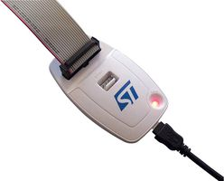
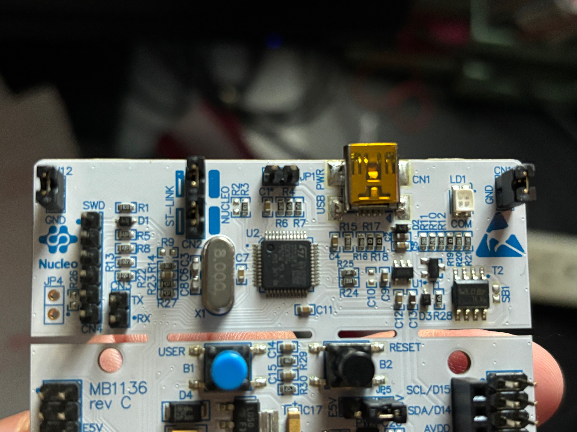
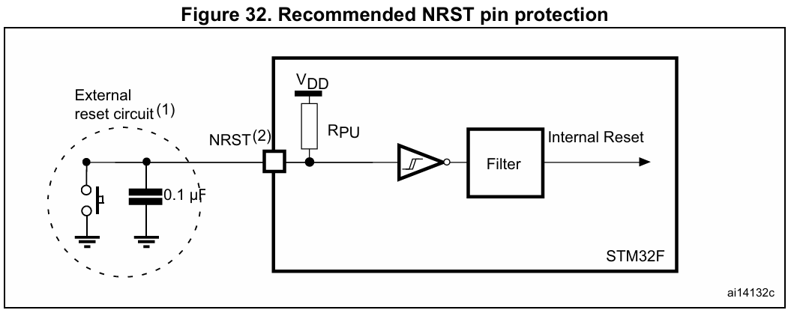
Programming/Debugging Interface
STM32 offers two kinds of programming/debugging interfaces: Serial Wire Debug (SWD) and JTAG
SWD is 2-pin interface
JTAG is more complex but more features
External debugger (ST-LINK usually) is needed to translate communication into something the STM32 accepts.
Our dev board has a debugger built-in and allows programming via USB.
Reset circuit to safely reset to stable state.

Slide 11
Demo: Bulk Capacitor
What is needed?
Software:
STM32CubeIDE
Hardware:
NUCLEO-F401
DMM/Oscilloscope
Breadboard
x2 Wires
x1 1mF (or other) Capacitor
x1 1kΩ (or other) Resistor
x1 470Ω Resistor

Slide 12
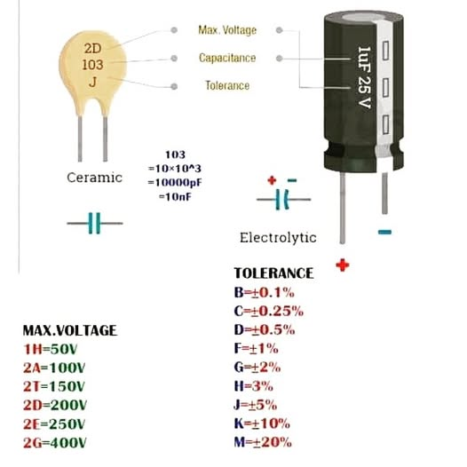
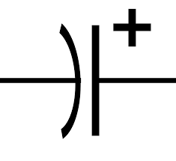
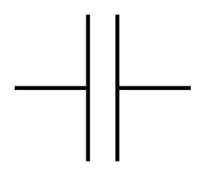
Demo: Bulk Capacitor
Polarized vs Non-Polarized
Ceramics/Film (No Polarity)
Code system for parameters
Used for lower capacitance
Electrolytic: Aluminum/Tantalum (Polarized)
WILL EXPLODE IF USED IN REVERSE. READ SCHEMATIC
White line usually a polarity marker for capacitor cathode

Slide 13
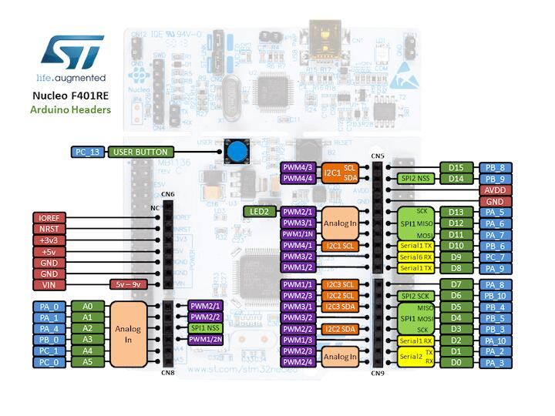
Demo: Bulk Capacitor
Pins on dev-board correspond to pins on the STM32 microcontroller:
We will use D8 on the dev board or pin PA9 on the STM32

Slide 14
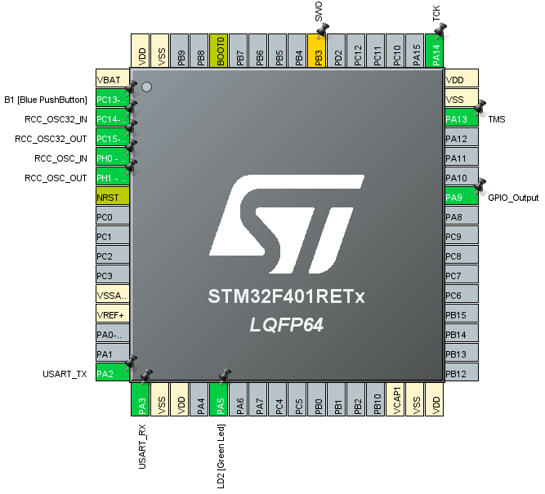
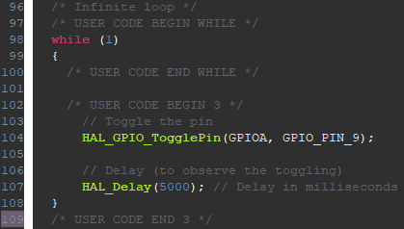
Demo: Bulk Capacitor
Open STM32CubeIDE -> Open Project -> Open .ioc file
Select PA9 and choose GPIO_Output
Save the file to generate updated code
Add following code to while loop:

Slide 15
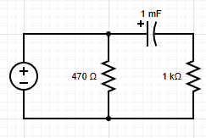
Demo: Bulk Capacitor
D8 Pin
+ Probe
- Probe
Add components on breadboard connected like the right:
Compile and run the code in the IDE
Use oscilloscope or DMM to measure the voltage across the capacitor and notice how it slowly changes voltage despite the almost instantaneous voltage change on the D8 pin.
Time constant (𝜏) = Total Resistance * Total Capacitance
𝜏 = (470Ω + 1kΩ) * (1mF) = 1.47 seconds
Larger 𝜏 means capacitor will charge and discharge at a slower rate.
GND

Slide 16
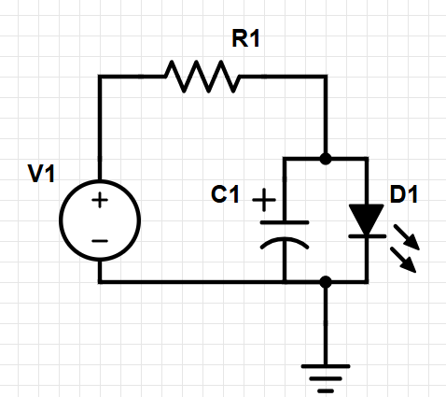
Supplemental Demo: Flickering Light
Situation: A surgical room uses one LED for lighting. The lighting controls are in a room with heavy machinery in motion which vibrate and cause low frequency electrical noise in the system, resulting in flickering lights. A surgeon has an open heart surgery scheduled and needs consistent lighting for 6 hours of surgery. Use capacitors to fix the flickering.
Solution:
Add components on breadboard connected like the right:
Time constant (𝜏) = Total Resistance * Total Capacitance
𝜏 = (470Ω + 1kΩ) * (1mF) = 1.47 seconds
Larger 𝜏 means capacitor will charge and discharge at a slower rate.
+
STM32
(output)
-

Slide 17
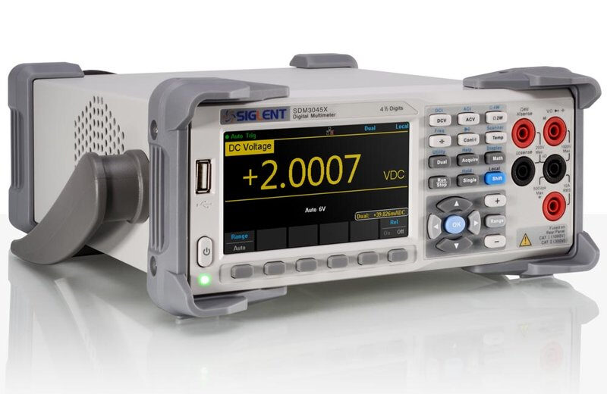
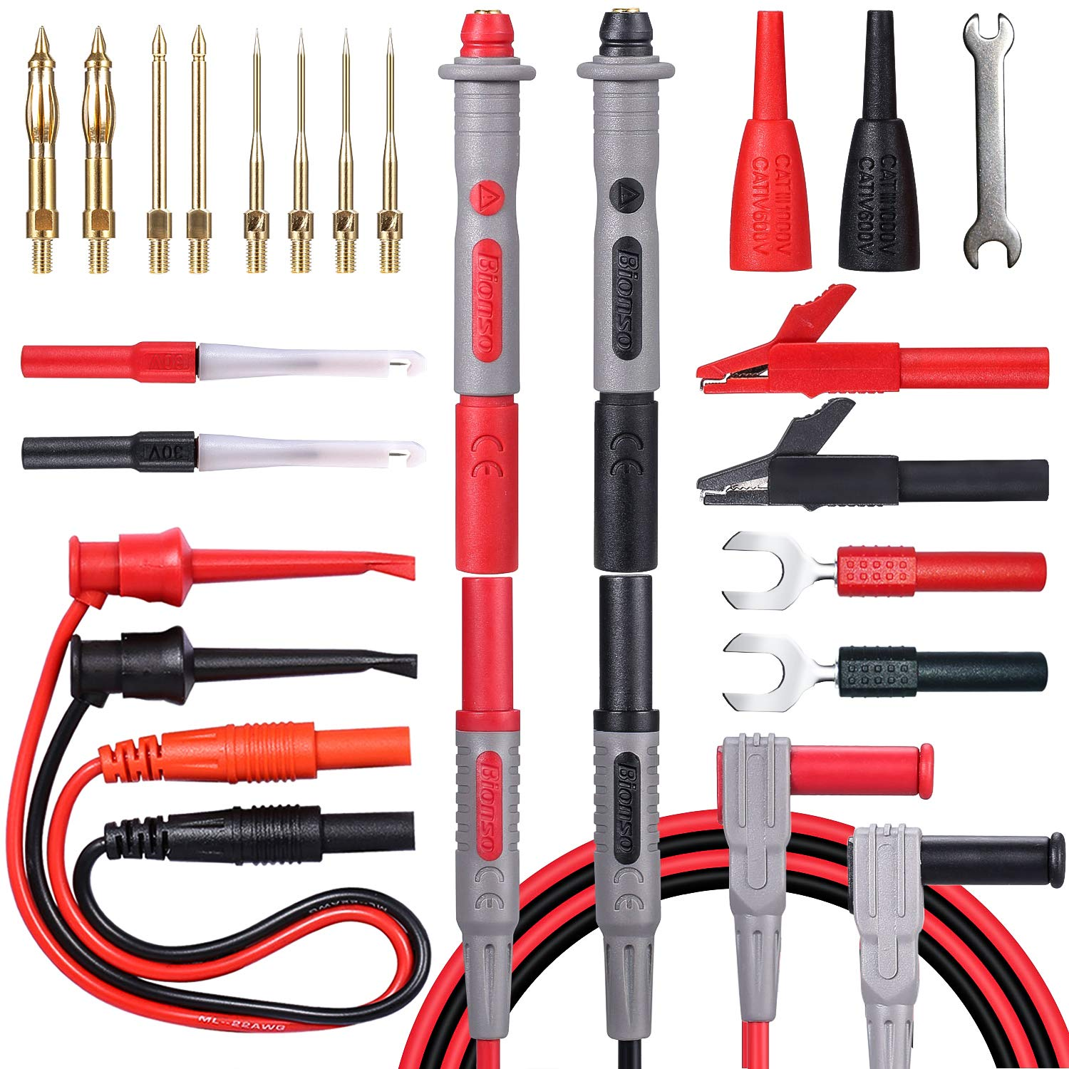
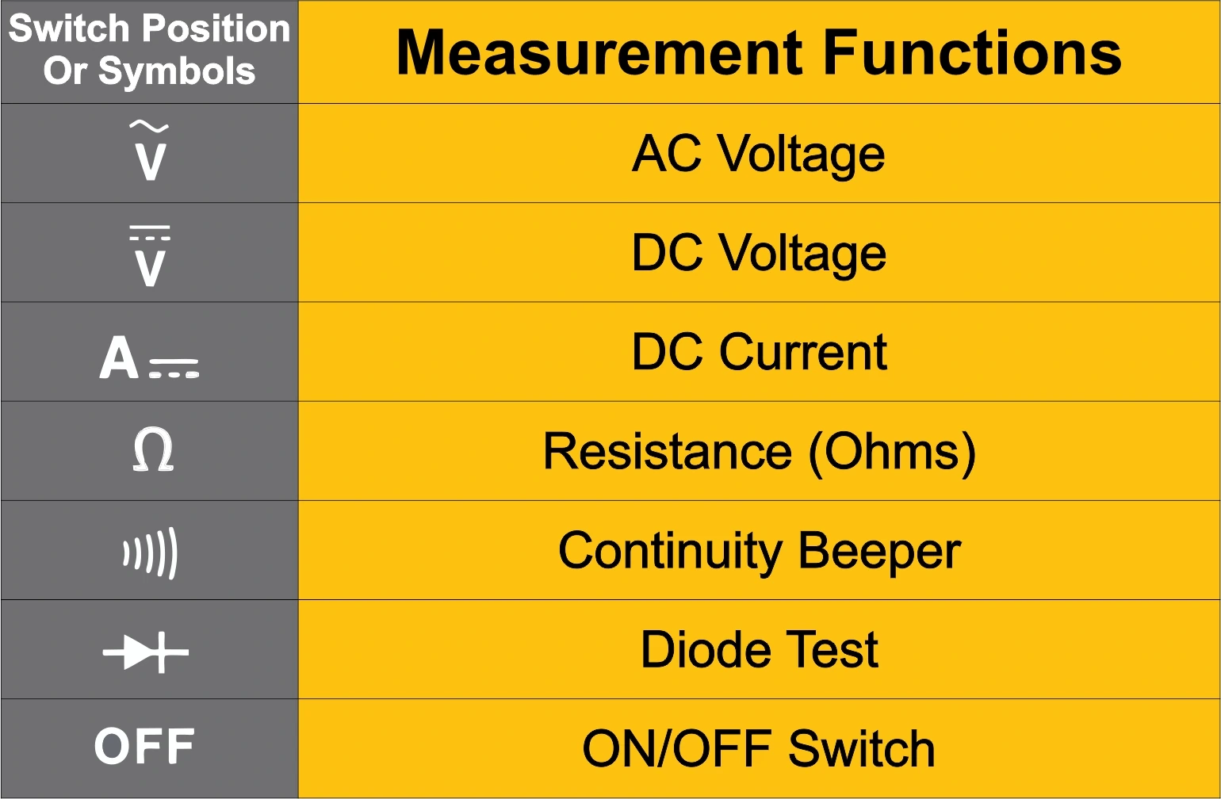
Reference: Multimeter
How to use a multimeter:
Can use probes or alligator clips
Function
Range
Reading 0 or near zero(unexpected?)
Test your power supply and leads
Continuity test your jumper wires
Are you on the right function? (- -V ≠ ~V)
Are you on the right range? (Adjust the units: μ,m,K)

Slide 18
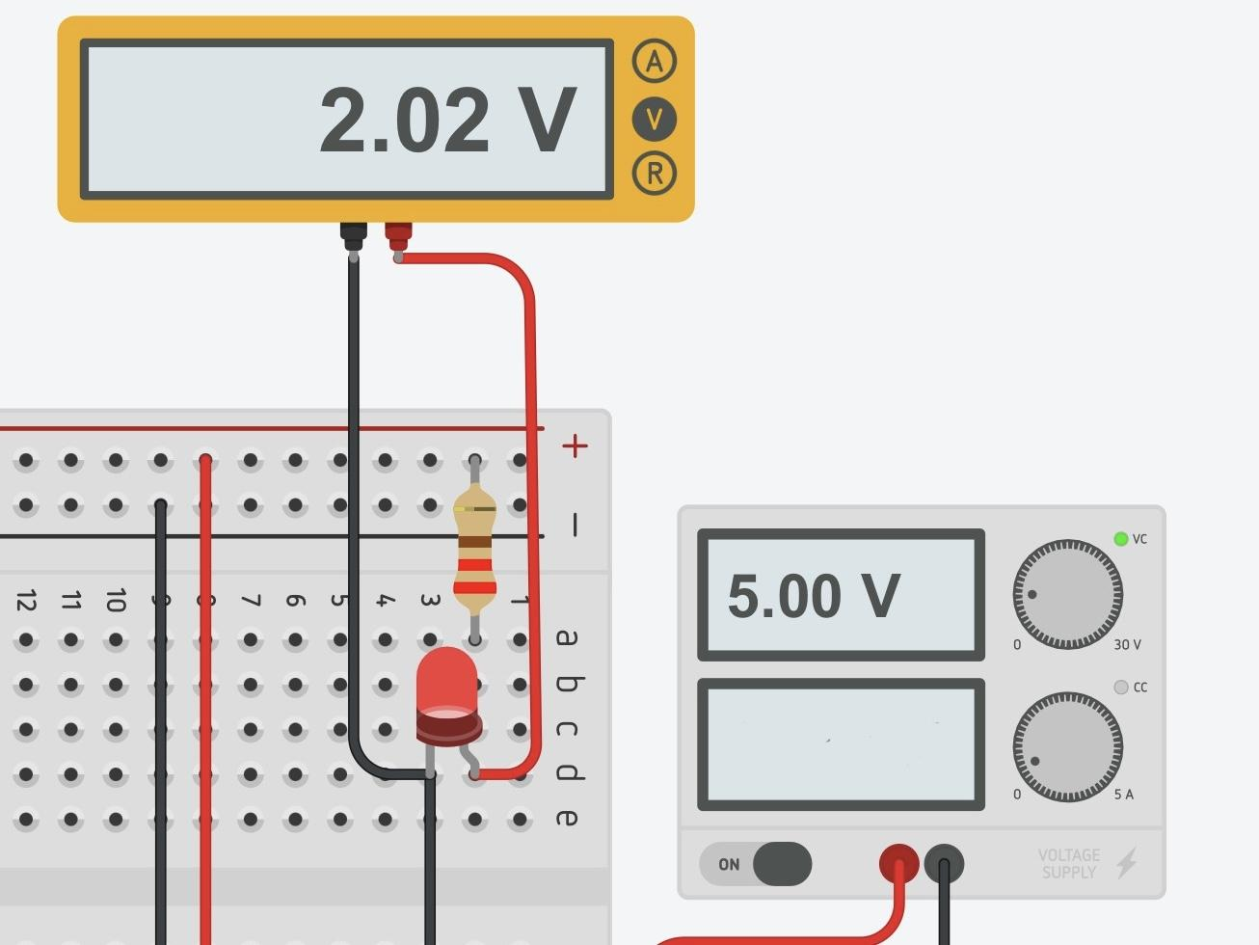
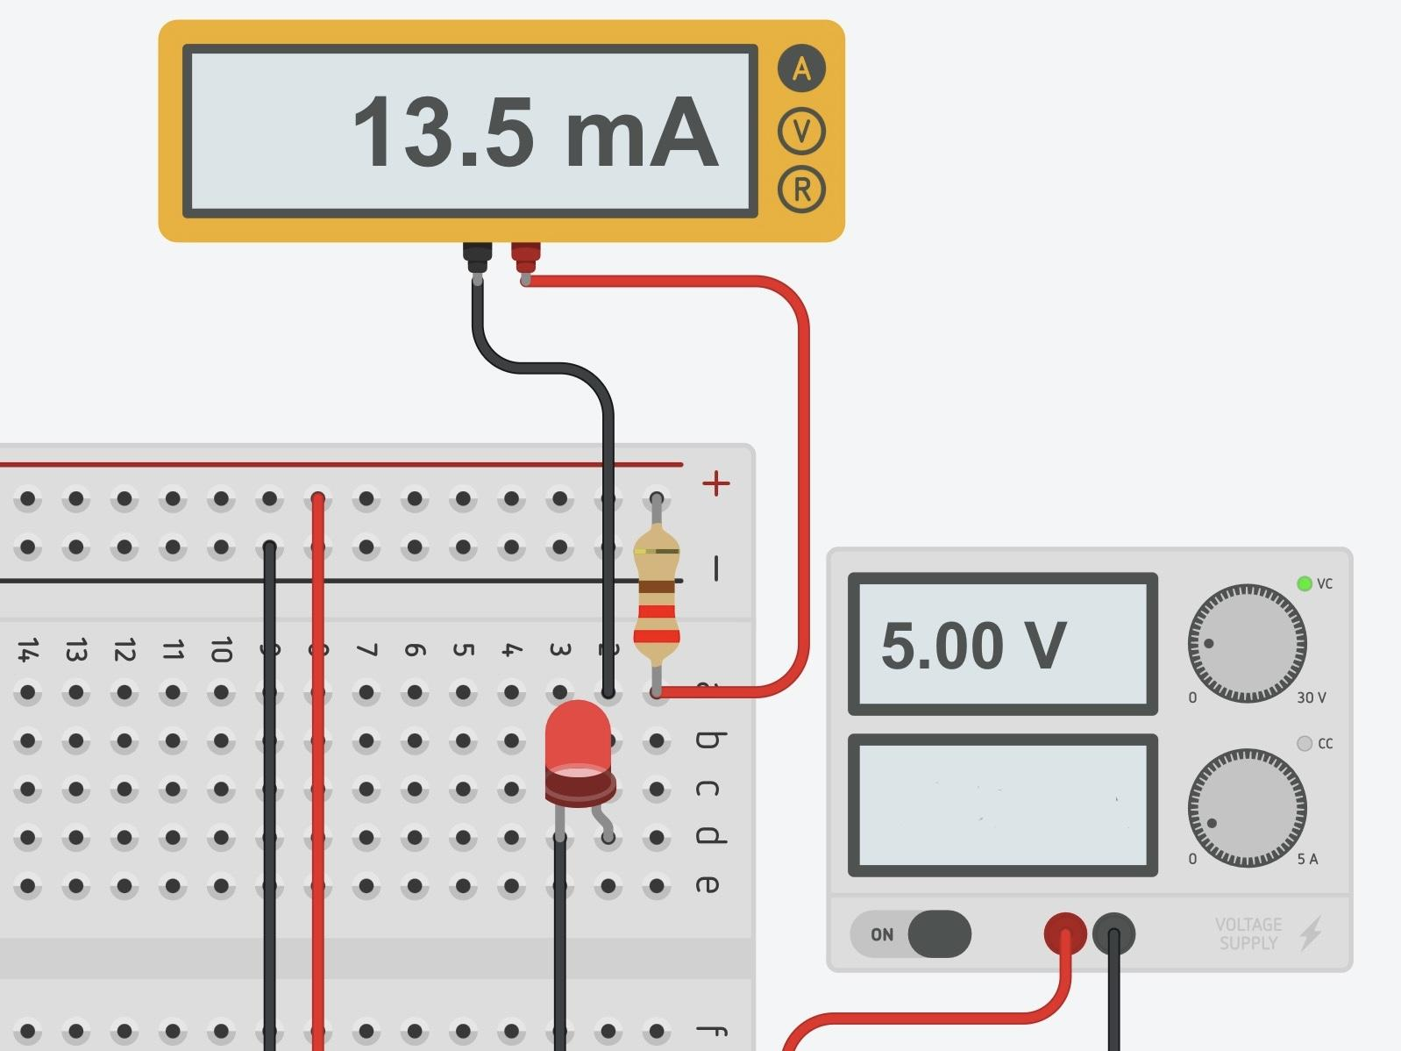
Reference: Multimeter
How to use a multimeter
Can use probes or alligator clips
Measuring Voltage
Measuring Current

Slide 19
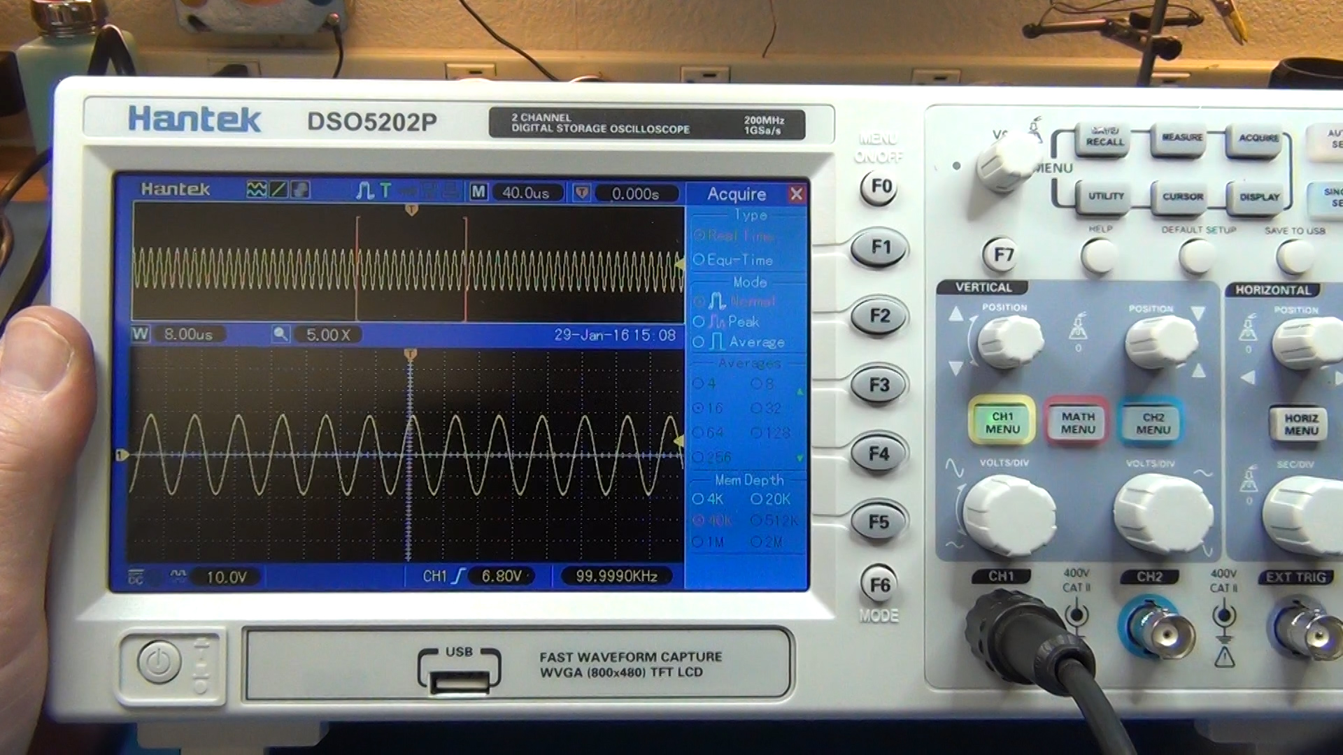
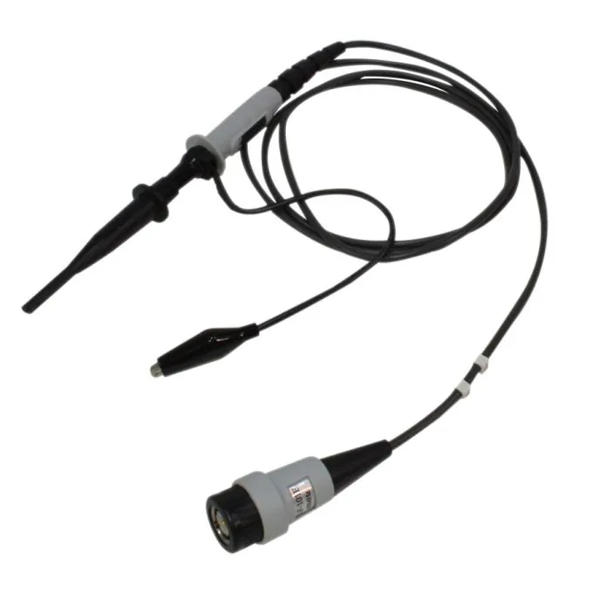
Reference: Oscilloscope
How to use an oscilloscope (o-scope):
Uses BNC connector (twist and lock)
“Channels” display output waveform of the voltage(Y-axis) vs time(X-axis)
Use the correct leads: signal hook and ground clip
Ensure the scale is at 1X not 100X
You can test your lead by hooking to the 2V hook
“Autoscale” adjusts the waveform view for a clearer view
Axes are not labeled. Your data is displayed on “measure”

Slide 20
Join us next meeting for STM32 Peripherals!
Nothing new is needed for next week. Any Questions?

